Slide 1
Game Theory and pollution control Nathan Nickelson 2018
The Reboot

Slide 2

The Context

Slide 3
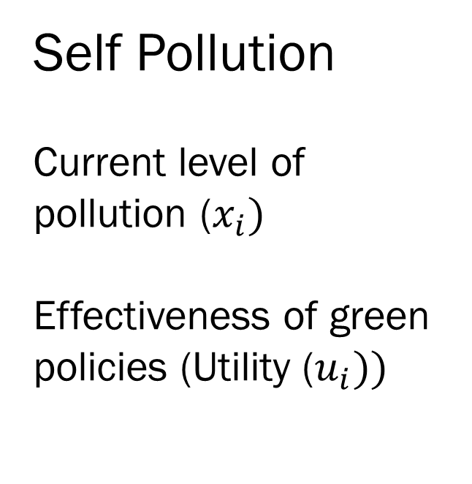
Rate of Pollution
Self Pollution
Current level of pollution ($x_{i})$
Effectiveness of green policies (Utility ($u_{i}))$

Slide 4
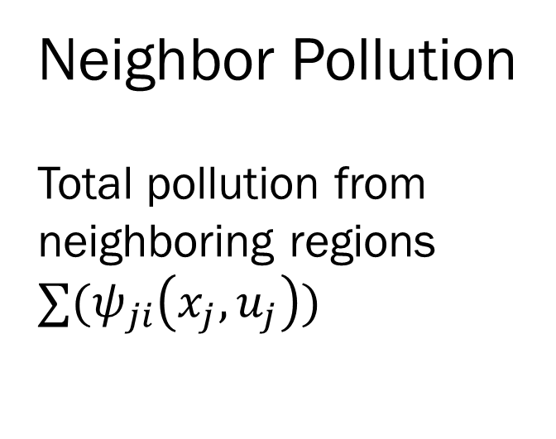
Rate of Pollution
Neighbor Pollution
Total pollution from neighboring regions $∑(ψ_{ji}\left(x_{j},u_{j}\right))$

Slide 5

The Dirty Equation :
$${\dot{x}}_{i}=\left(1−u_{i}\left(t\right)\right)x_{i}\left(t\right)+ \sum_{j∈N^{i}}{\left(ψ_{ij} \left(1−u_{j}\left(t\right)\right)x_{j}\left(t\right)\right)− u_{i}\left(t\right)x_{i} (t)}$$
$x_{i}(t)$: Pollution stock at time (t)
$u_{i}\left(t\right):$ Investment into environmentally friendly policies [0,1]
$ψ_{ji}$: Rate country j pollutes country i [0,1]

Slide 6

Evaluate $u_{i}(t)$ – The Utility function
The Utility function affects the total pollution and, therefore, the rate of change in pollution
Analyze this function in 2 and 3 player scenarios and generalize the results

Slide 7
Finding the stability region
For each player’s utility function, what values will stabilize pollutants?
Generalization

Slide 8
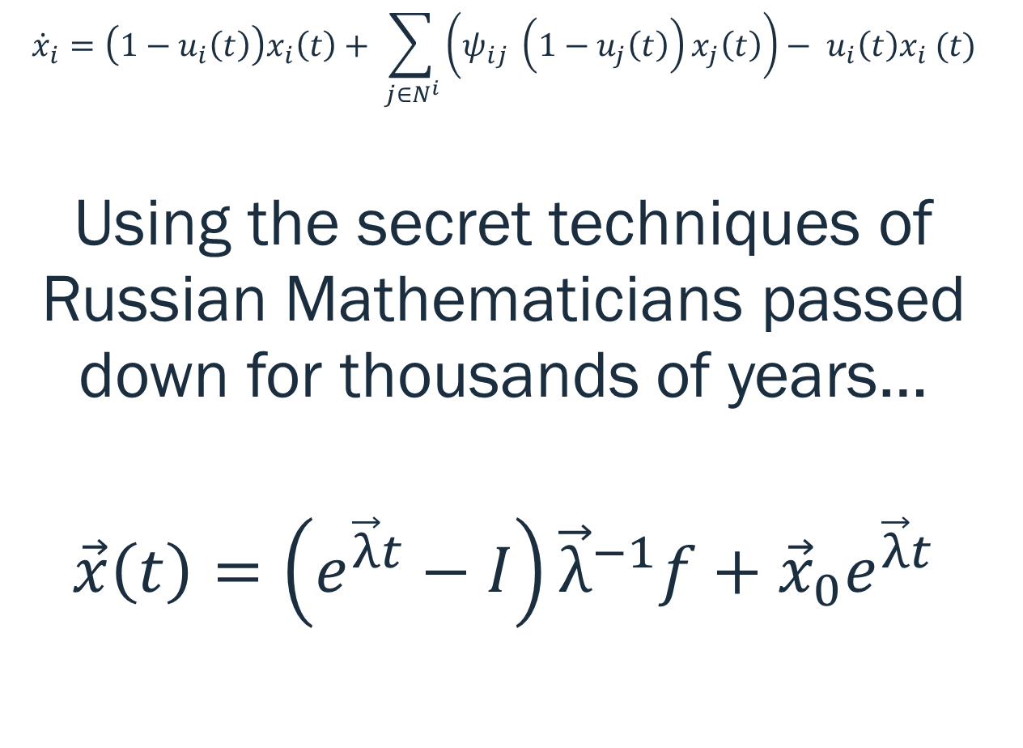
Finding the stability region
$${\dot{x}}_{i}=\left(1−u_{i}\left(t\right)\right)x_{i}\left(t\right)+ \sum_{j∈N^{i}}{\left(ψ_{ij} \left(1−u_{j}\left(t\right)\right)x_{j}\left(t\right)\right)− u_{i}\left(t\right)x_{i} (t)}$$
Using the secret techniques of Russian Mathematicians passed down for thousands of years…
$$\vec{x}\left(t\right)=\left(e^{\vec{λ}t}−I\right){\vec{λ}}^{−1}f+{\vec{x}}_{0}e^{\vec{λ}t}$$
Generalization

Slide 9
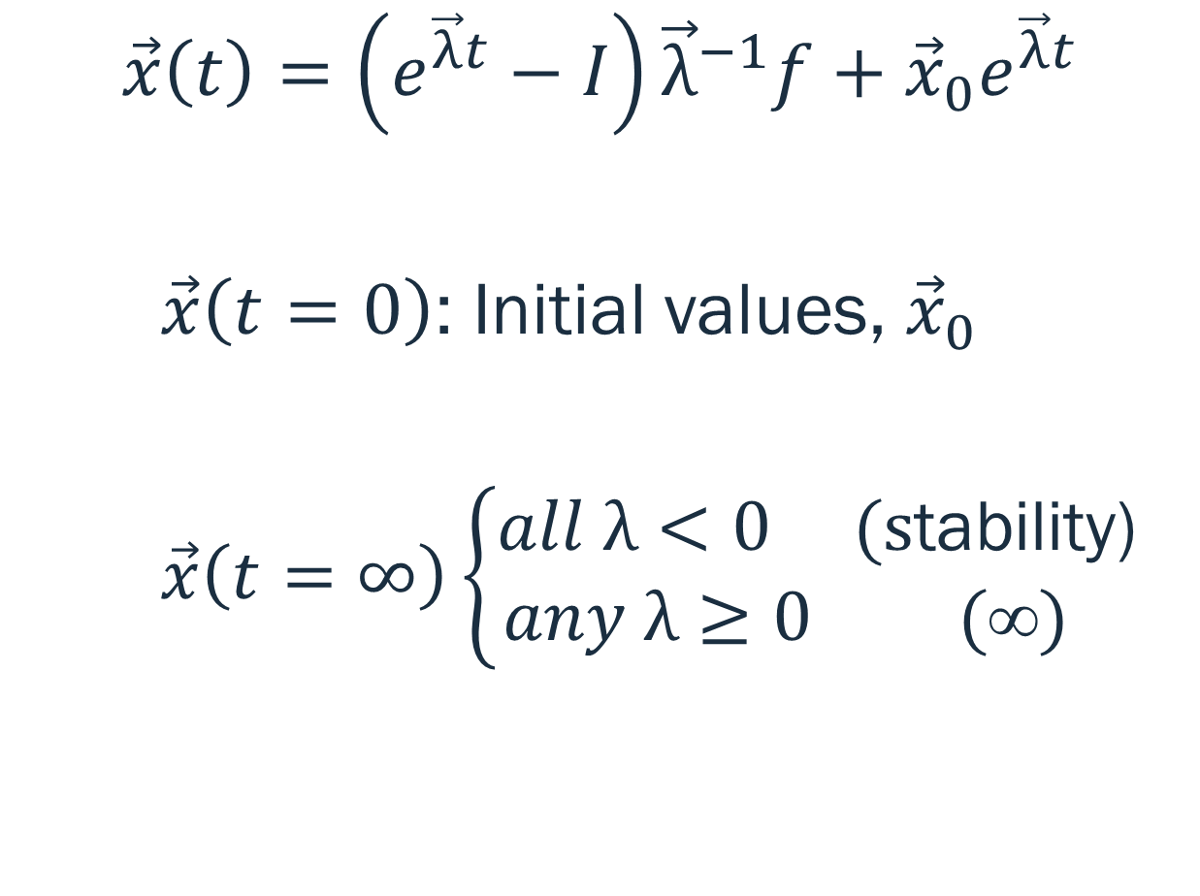
Finding the stability region
$$\vec{x}\left(t\right)=\left(e^{\vec{λ}t}−I\right){\vec{λ}}^{−1}f+{\vec{x}}_{0}e^{\vec{λ}t}$$
$\vec{x}\left(t=0\right)$: Initial values, ${\vec{x}}_{0}$
$\vec{x}\left(t=∞\right)\left\{\begin{aligned}all λ<0 \text{(}\text{s}\text{tability}\text{)} \\ any λ≥0\text{ (}\text{∞}) \end{aligned}\right.$
Properties

Slide 10

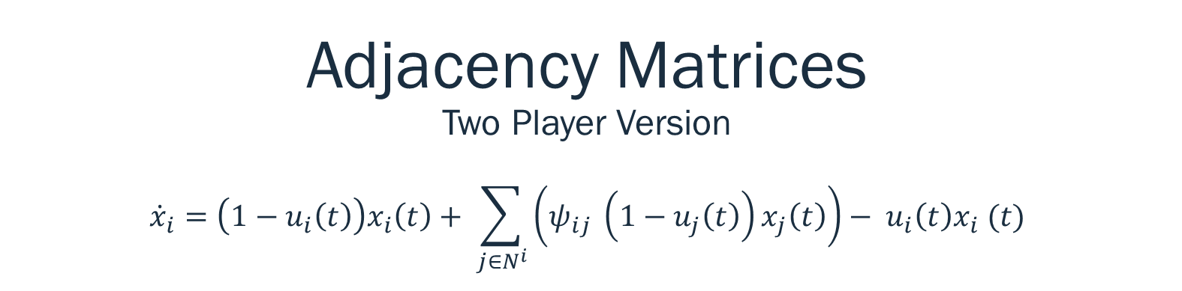
Adjacency Matrices Two Player Version $${\dot{x}}_{i}=\left(1−u_{i}\left(t\right)\right)x_{i}\left(t\right)+ \sum_{j∈N^{i}}{\left(ψ_{ij} \left(1−u_{j}\left(t\right)\right)x_{j}\left(t\right)\right)− u_{i}\left(t\right)x_{i} (t)}$$
Minnesota North Dakota
$$\left[\begin{matrix}1−{2u}_{1} & 1−u_{2} \\ 1−u_{1} & 1−{2u}_{2}\end{matrix}\right]$$
Minnesota
North Dakota

Slide 11
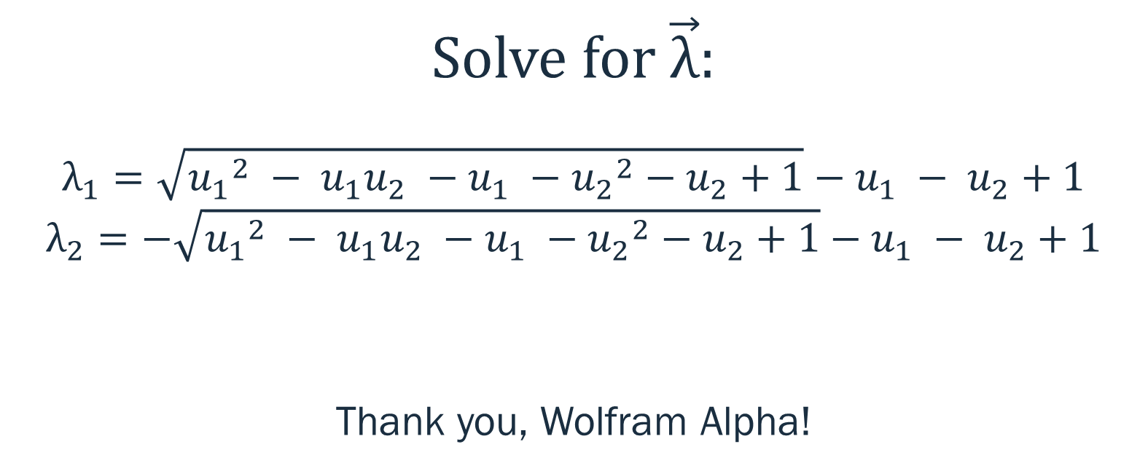
For Two Players:
Solve for $\vec{λ}$:
$$λ_{1}=\sqrt{{u_{1}}^{2} − u_{1}u_{2} −u_{1} −{u_{2}}^{2}−u_{2}+1}−u_{1} − u_{2}+1$$
$$λ_{2}=−\sqrt{{u_{1}}^{2} − u_{1}u_{2} −u_{1} −{u_{2}}^{2}−u_{2}+1}−u_{1} − u_{2}+1$$
Thank you, Wolfram Alpha!

Slide 12
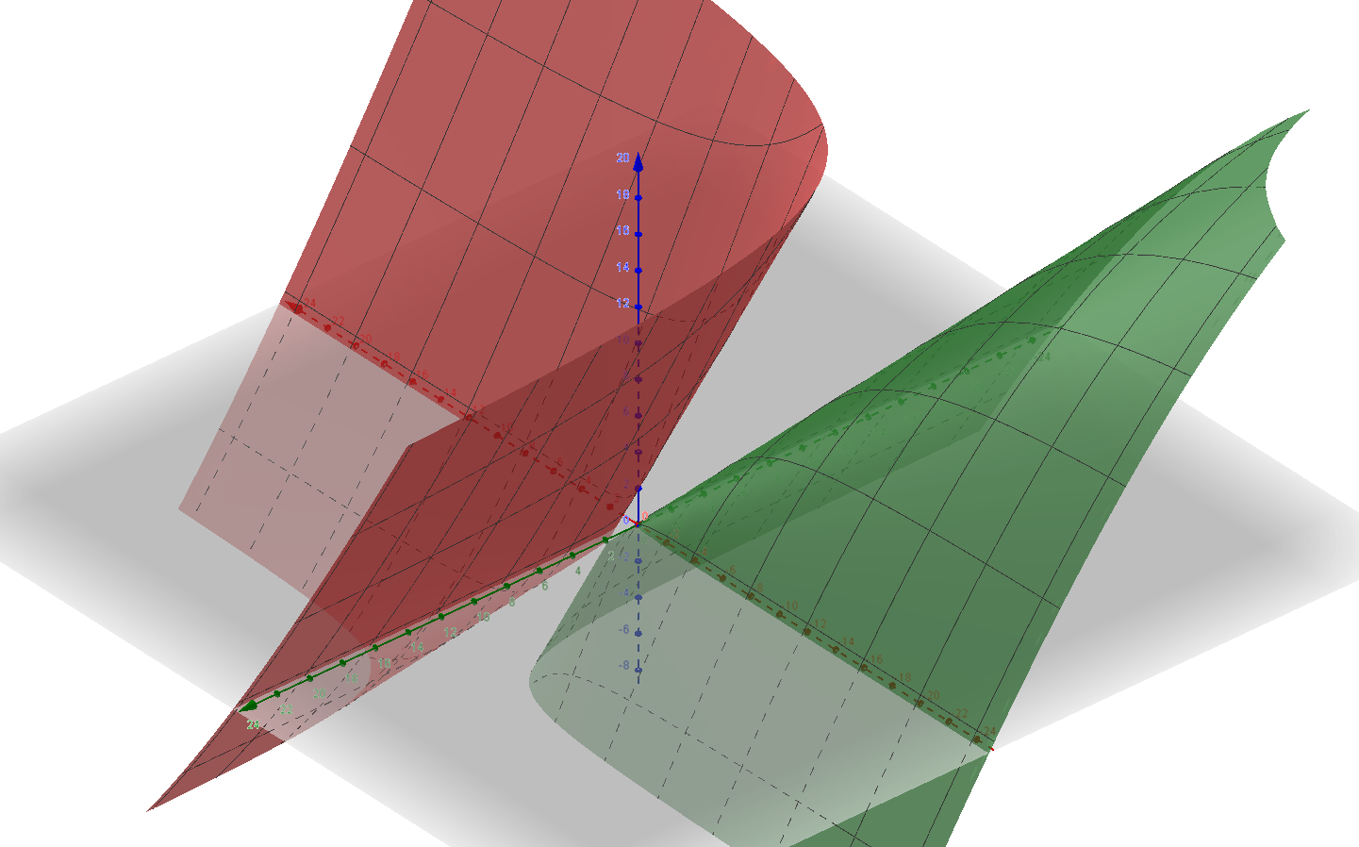
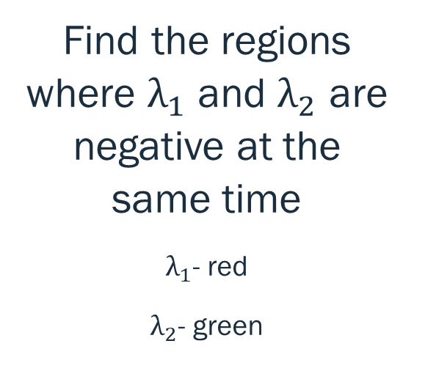
The Eigenvalue Graph
Find the regions where $λ_{1}$ and $λ_{2}$ are negative at the same time
$λ_{1}$- red
$λ_{2}$- green
www.Geogrebra.org

Slide 13
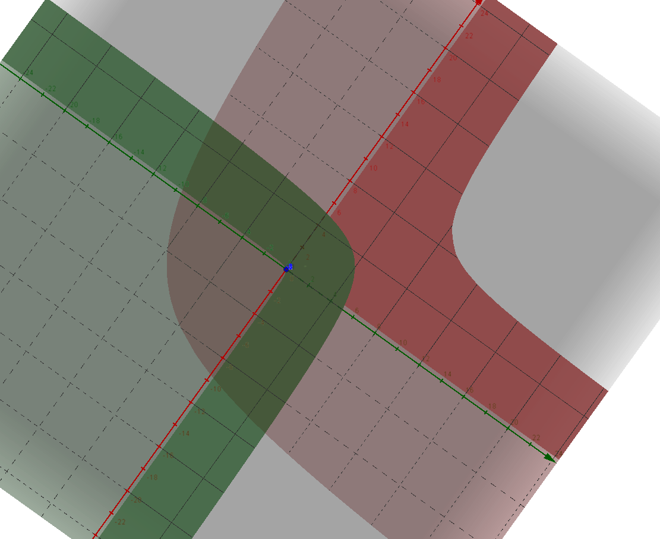
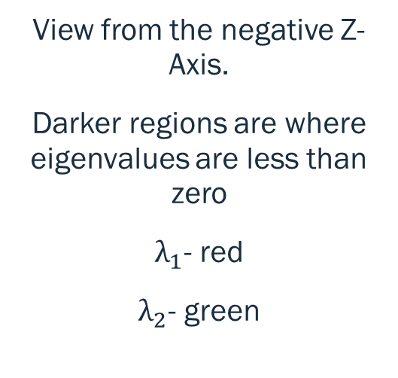
The Eigenvalue Graph
Q4
Q1
View from the negative Z-Axis.
Darker regions are where eigenvalues are less than zero
$λ_{1}$- red
$λ_{2}$- green
Q3
Q2
www.Geogrebra.org

Slide 14
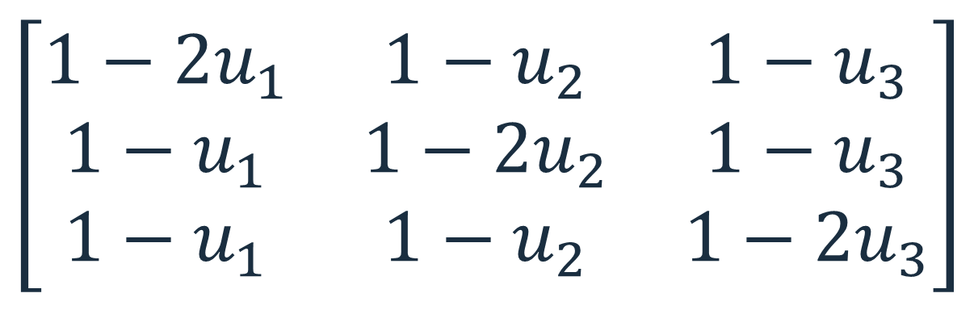
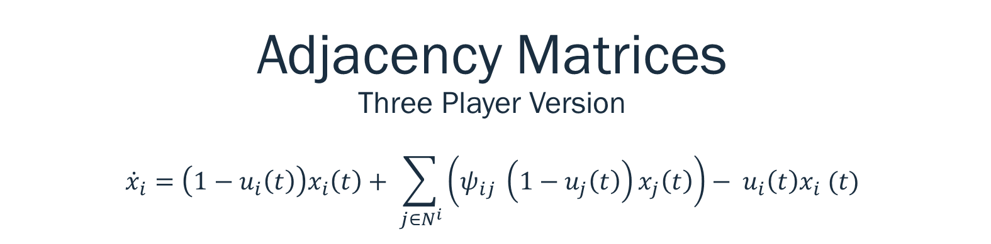
Adjacency Matrices Three Player Version $${\dot{x}}_{i}=\left(1−u_{i}\left(t\right)\right)x_{i}\left(t\right)+ \sum_{j∈N^{i}}{\left(ψ_{ij} \left(1−u_{j}\left(t\right)\right)x_{j}\left(t\right)\right)− u_{i}\left(t\right)x_{i} (t)}$$
Minnesota North Dakota South Dakota
$$\left[\begin{matrix}1−2u_{1} & 1−u_{2} & 1−u_{3} \\ 1−u_{1} & 1−2u_{2} & 1−u_{3} \\ 1−u_{1} & 1−u_{2} & 1−{2u}_{3}\end{matrix}\right]$$
Minnesota
North Dakota
South Dakota

Slide 15
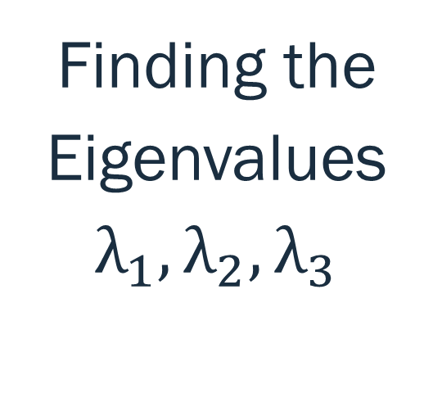
Three Players
Solving this for three players?
It gets messy quickly….
Wolfram Alpha to the rescue again…..
Finding the Eigenvalues $λ_{1},λ_{2},λ_{3}$

Slide 16
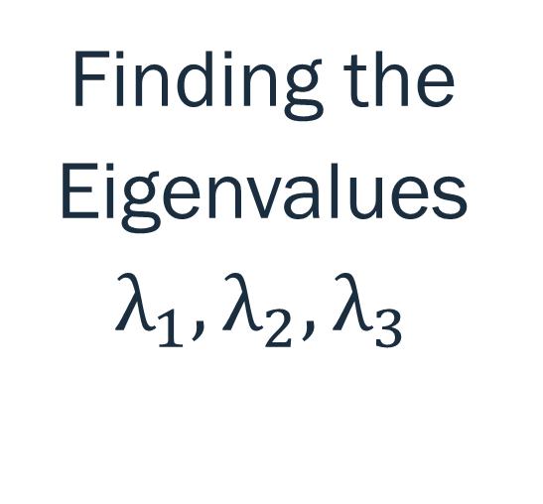
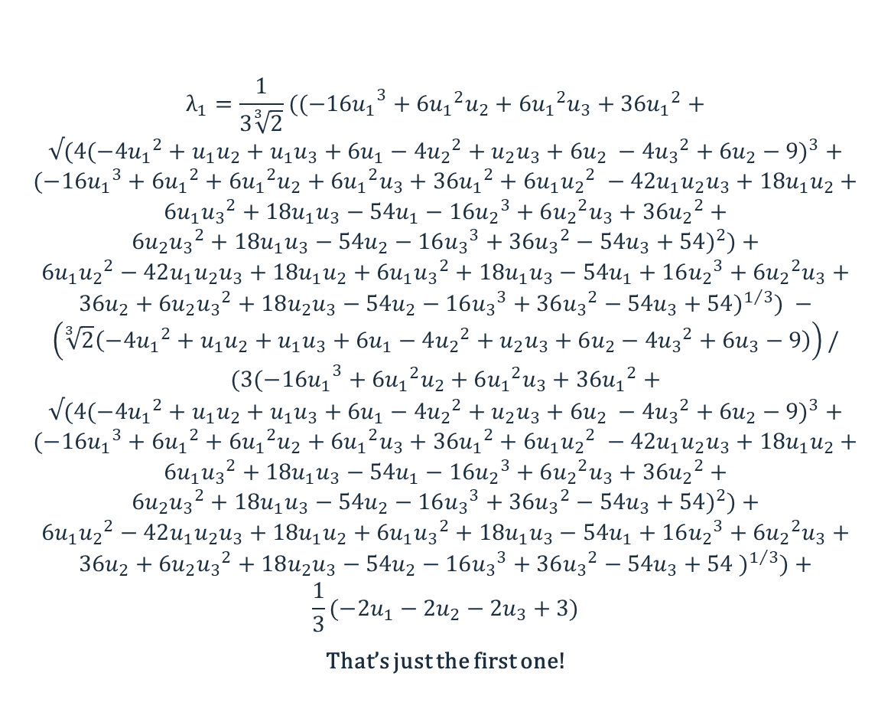
Three Players
$$λ_{1}=\frac{1}{3\sqrt[3]{2}}((−{16u_{1}}^{3}+6{u_{1}}^{2}u_{2}+6{u_{1}}^{2}u_{3}+36{u_{1}}^{2}+$$
$$√(4(−4{u_{1}}^{2}+u_{1}u_{2}+u_{1}u_{3}+6u_{1}−4{u_{2}}^{2}+u_{2}u_{3}+6u_{2} −4{u_{3}}^{2}+6u_{2}−9)^{3}+$$
$$(−16{u_{1}}^{3}+6{u_{1}}^{2}+6{u_{1}}^{2}u_{2}+6{u_{1}}^{2}u_{3}+36{u_{1}}^{2}+6u_{1}{u_{2}}^{2} −42u_{1}u_{2}u_{3}+18u_{1}u_{2}+$$
$$6u_{1}{u_{3}}^{2}+18u_{1}u_{3}−54u_{1}−16{u_{2}}^{3}+6{u_{2}}^{2}u_{3}+36{u_{2}}^{2}+$$
$$6{u_{2}u_{3}}^{2}+18u_{1}u_{3}−54u_{2}−16{u_{3}}^{3}+36{u_{3}}^{2}−54u_{3}+54)^{2})+$$
$$6u_{1}{u_{2}}^{2}−42u_{1}u_{2}u_{3}+18u_{1}u_{2}+6u_{1}{u_{3}}^{2}+18u_{1}u_{3}−54u_{1}+16{u_{2}}^{3}+6{u_{2}}^{2}u_{3}+$$
$$36u_{2}+6{u_{2}u_{3}}^{2}+18u_{2}u_{3}−54u_{2}−16{u_{3}}^{3}+36{u_{3}}^{2}−54u_{3}+54)^{1/3}) −$$
$$\left(\sqrt[3]{2}\left(−4{u_{1}}^{2}+u_{1}u_{2}+u_{1}u_{3}+6u_{1}−4{u_{2}}^{2}+u_{2}u_{3}+6u_{2}−4{u_{3}}^{2}+6u_{3}−9\right)\right)/$$
$$(3(−{16u_{1}}^{3}+6{u_{1}}^{2}u_{2}+6{u_{1}}^{2}u_{3}+36{u_{1}}^{2}+$$
$$√(4(−4{u_{1}}^{2}+u_{1}u_{2}+u_{1}u_{3}+6u_{1}−4{u_{2}}^{2}+u_{2}u_{3}+6u_{2} −4{u_{3}}^{2}+6u_{2}−9)^{3}+$$
$$(−16{u_{1}}^{3}+6{u_{1}}^{2}+6{u_{1}}^{2}u_{2}+6{u_{1}}^{2}u_{3}+36{u_{1}}^{2}+6u_{1}{u_{2}}^{2} −42u_{1}u_{2}u_{3}+18u_{1}u_{2}+$$
$$6u_{1}{u_{3}}^{2}+18u_{1}u_{3}−54u_{1}−16{u_{2}}^{3}+6{u_{2}}^{2}u_{3}+36{u_{2}}^{2}+$$
$$6{u_{2}u_{3}}^{2}+18u_{1}u_{3}−54u_{2}−16{u_{3}}^{3}+36{u_{3}}^{2}−54u_{3}+54)^{2})+$$
$$6u_{1}{u_{2}}^{2}−42u_{1}u_{2}u_{3}+18u_{1}u_{2}+6u_{1}{u_{3}}^{2}+18u_{1}u_{3}−54u_{1}+16{u_{2}}^{3}+6{u_{2}}^{2}u_{3}+$$
$$36u_{2}+6{u_{2}u_{3}}^{2}+18u_{2}u_{3}−54u_{2}−16{u_{3}}^{3}+36{u_{3}}^{2}−54u_{3}+54 )^{1/3})+$$
$$\frac{1}{3}(−2u_{1}−2u_{2}−2u_{3}+3)$$
That’s just the first one!
Finding the Eigenvalues $λ_{1},λ_{2},λ_{3}$

Slide 17
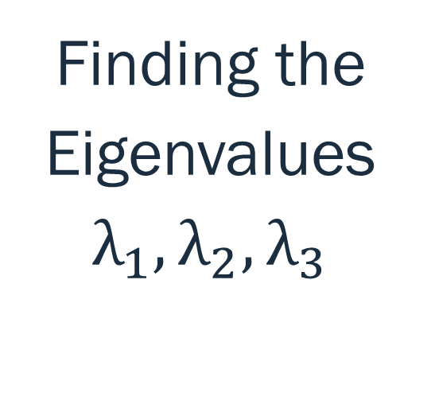
Three Players
Yuck.
Finding the Eigenvalues $λ_{1},λ_{2},λ_{3}$

Slide 18
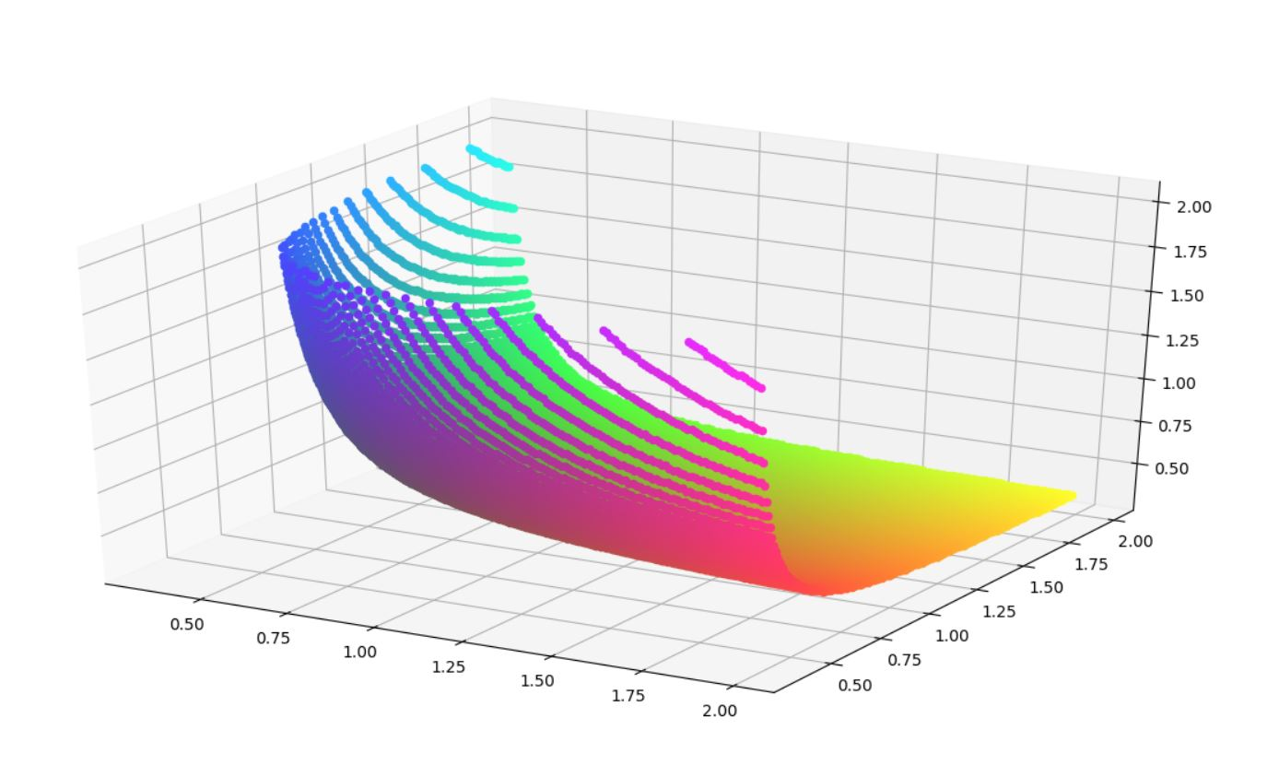
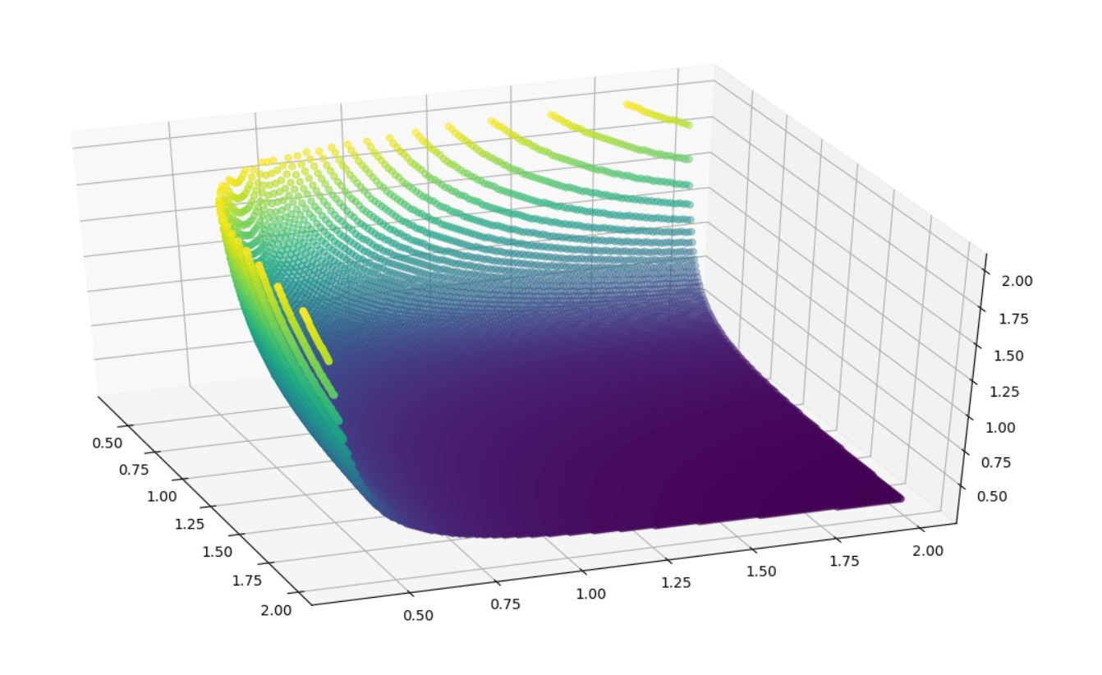
The Boundary Curve for Three Player Strategies

Slide 19
Three Players
Are there better options?
Finding the Eigenvalues $λ_{1},λ_{2},λ_{3}$

Slide 20
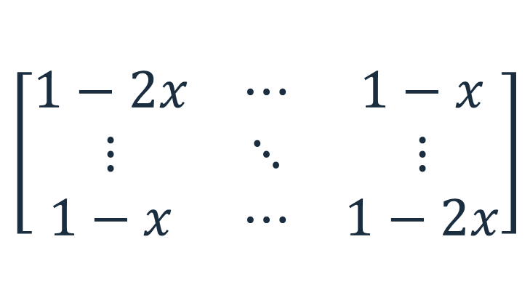
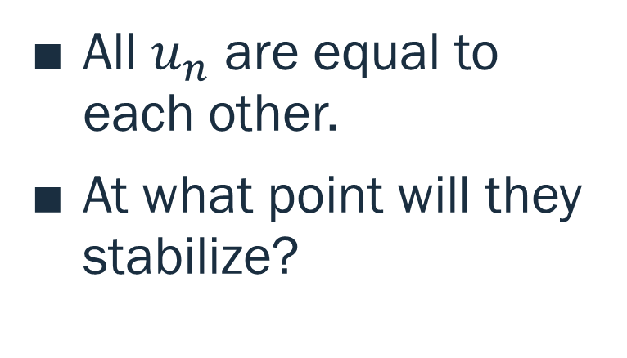
What if all players used the same strategy?
Assume:
Our matrix then would be:
All $u_{n}$ are equal to each other.
At what point will they stabilize?
$$\left[\begin{matrix}1−2x & ⋯ & 1−x \\ ⋮ & ⋱ & ⋮ \\ 1−x & ⋯ & 1−2x\end{matrix}\right]$$

Slide 21
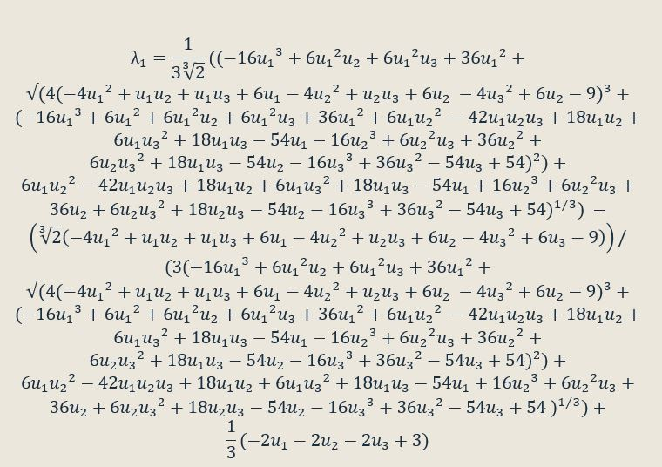


Three Players
If we let $u_{1}=u_{2}=u_{3}=x$
Then this:
Becomes:
$$λ_{1}=3 −4x$$
$$λ_{2}=−x$$
$$λ_{3}=−x$$
Finding the Eigenvalues $λ_{1},λ_{2},λ_{3}$

Slide 22
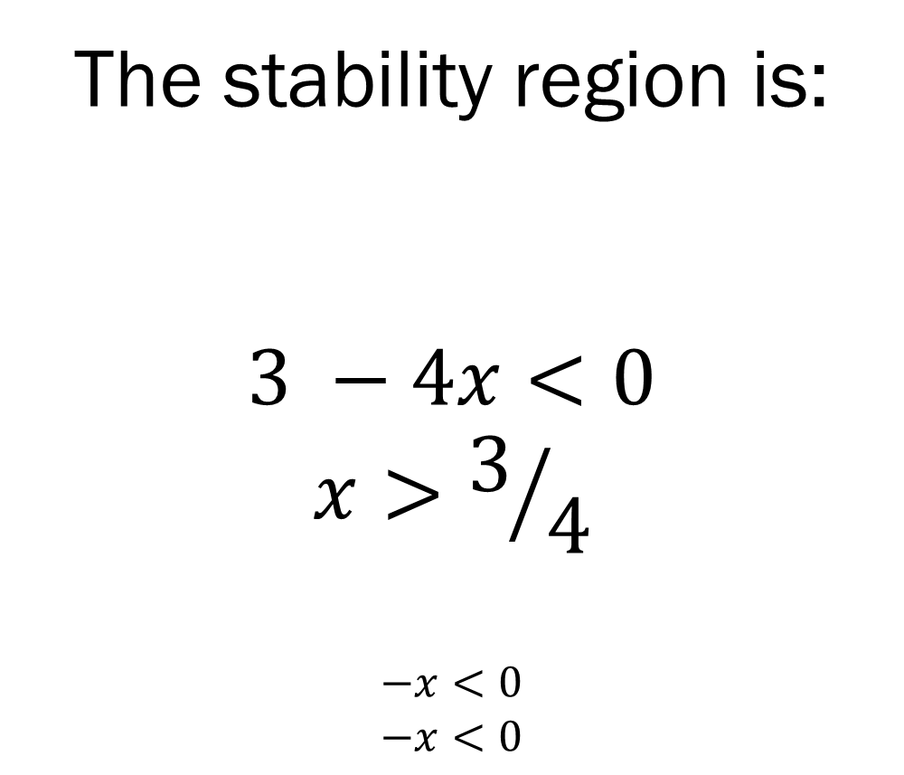
Three Players
The stability region is:
$$3 −4x<0$$
$$x>3/4$$
$$−x<0$$
$$−x<0$$
Finding the Eigenvalues $λ_{1},λ_{2},λ_{3}$

Slide 23
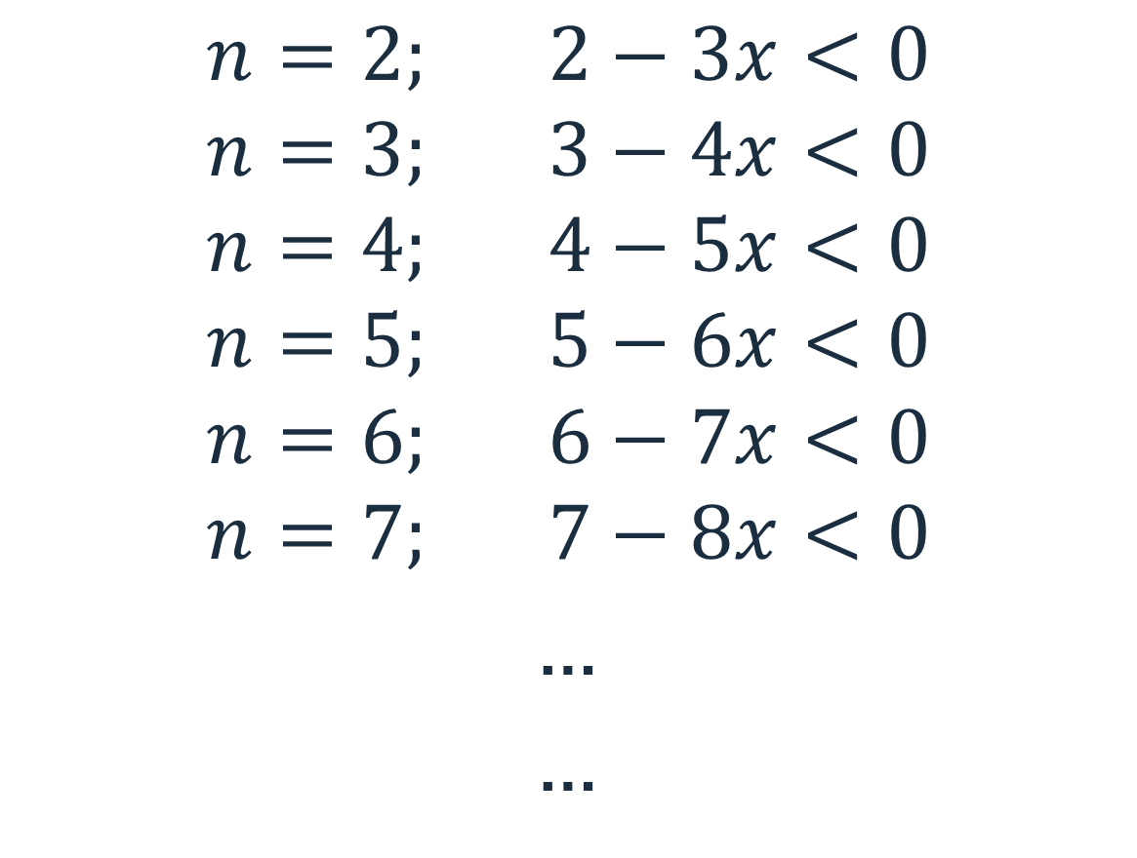

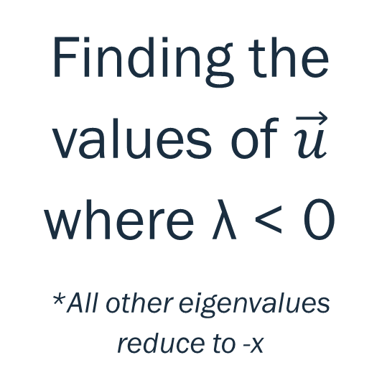
For $n$ Players
$$n=2; 2−3x<0$$
$$n=3; 3−4x<0$$
$$n=4; 4−5x<0$$
$$n=5; 5−6x<0$$
$$n=6; 6−7x<0$$
$$n=7; 7−8x<0$$
…
…
Finding the values of $\vec{u}$ where λ < 0
*All other eigenvalues reduce to -x

Slide 24
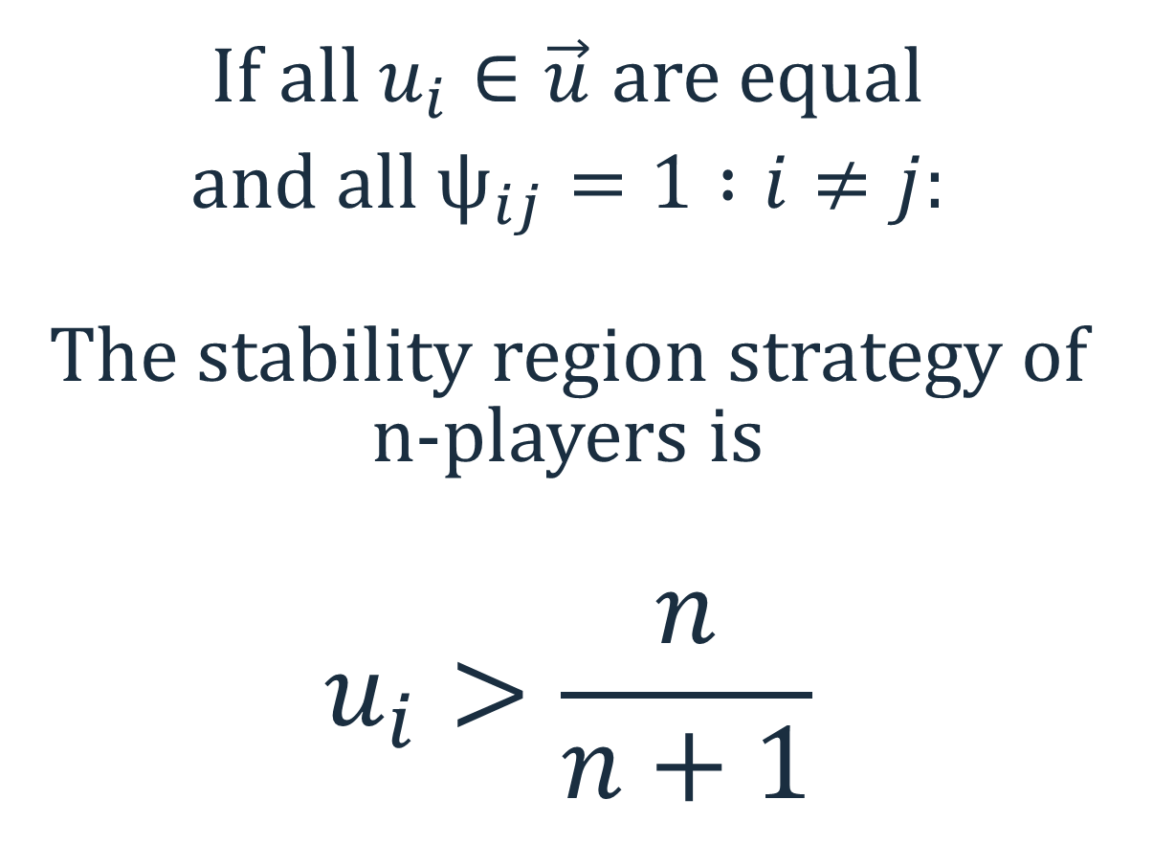
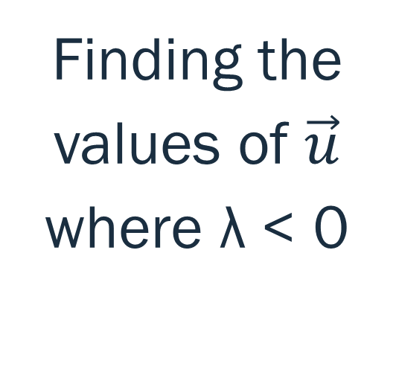
For $n$ Players
If all $u_{i}∈\vec{u}$ are equal
and all $ψ_{ij}=1 :i≠j:$
The stability region strategy of n-players is
$$u_{i}>\frac{n}{n+1}$$
Finding the values of $\vec{u}$ where λ < 0

Slide 25
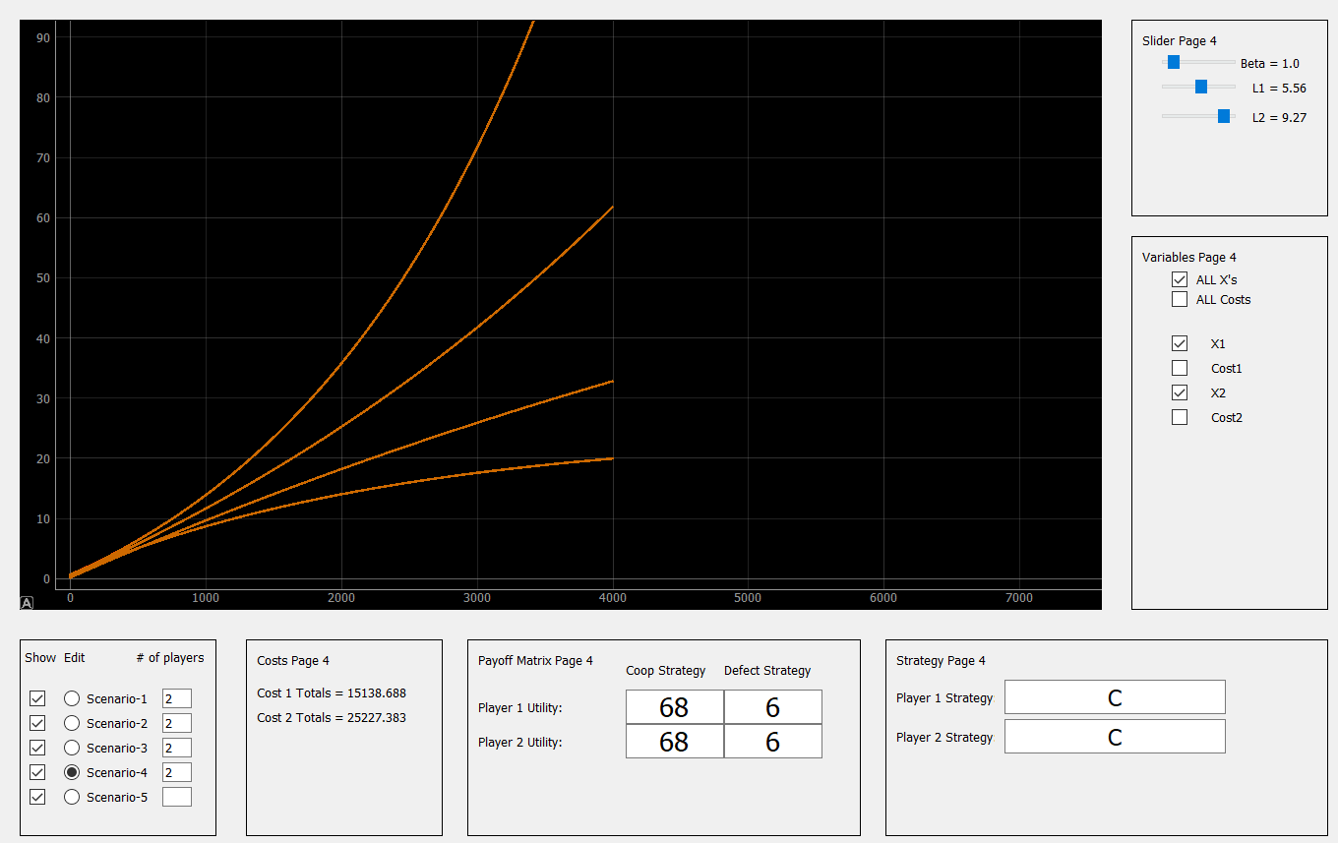
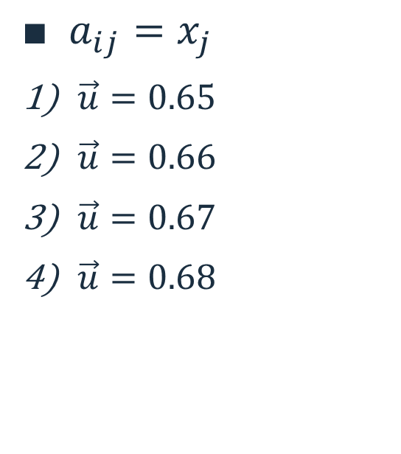
Two Player Testing
$a_{ij}=x_{j}$
$\vec{u}=0.65$
$\vec{u}=0.66$
$\vec{u}=0.67$
$\vec{u}=0.68$

Slide 26
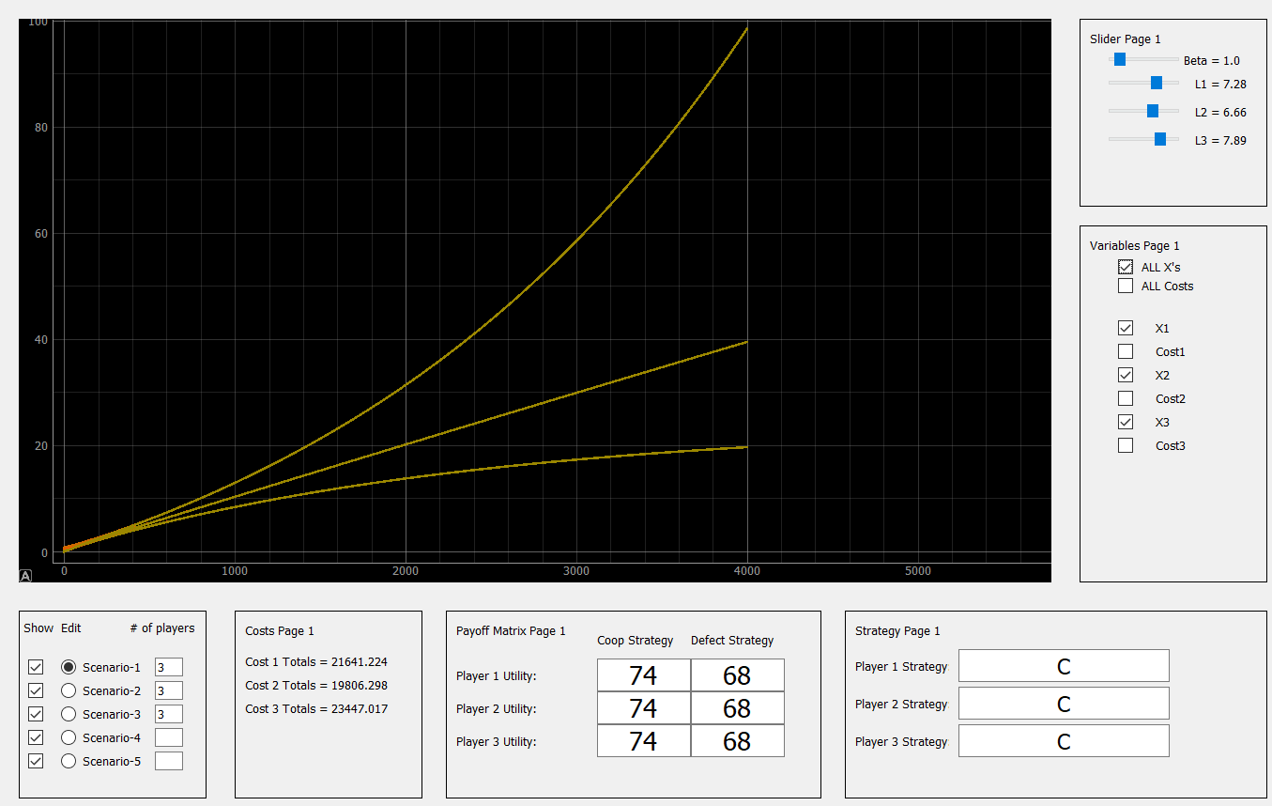
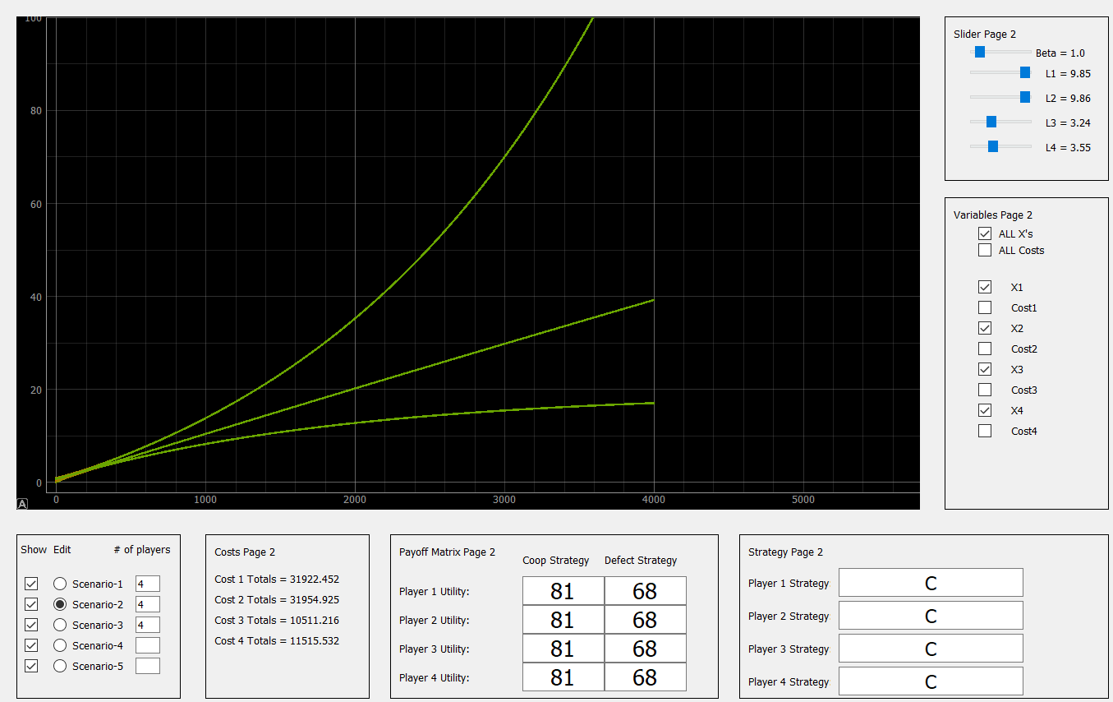
Testing
3-player
4-player

Slide 27
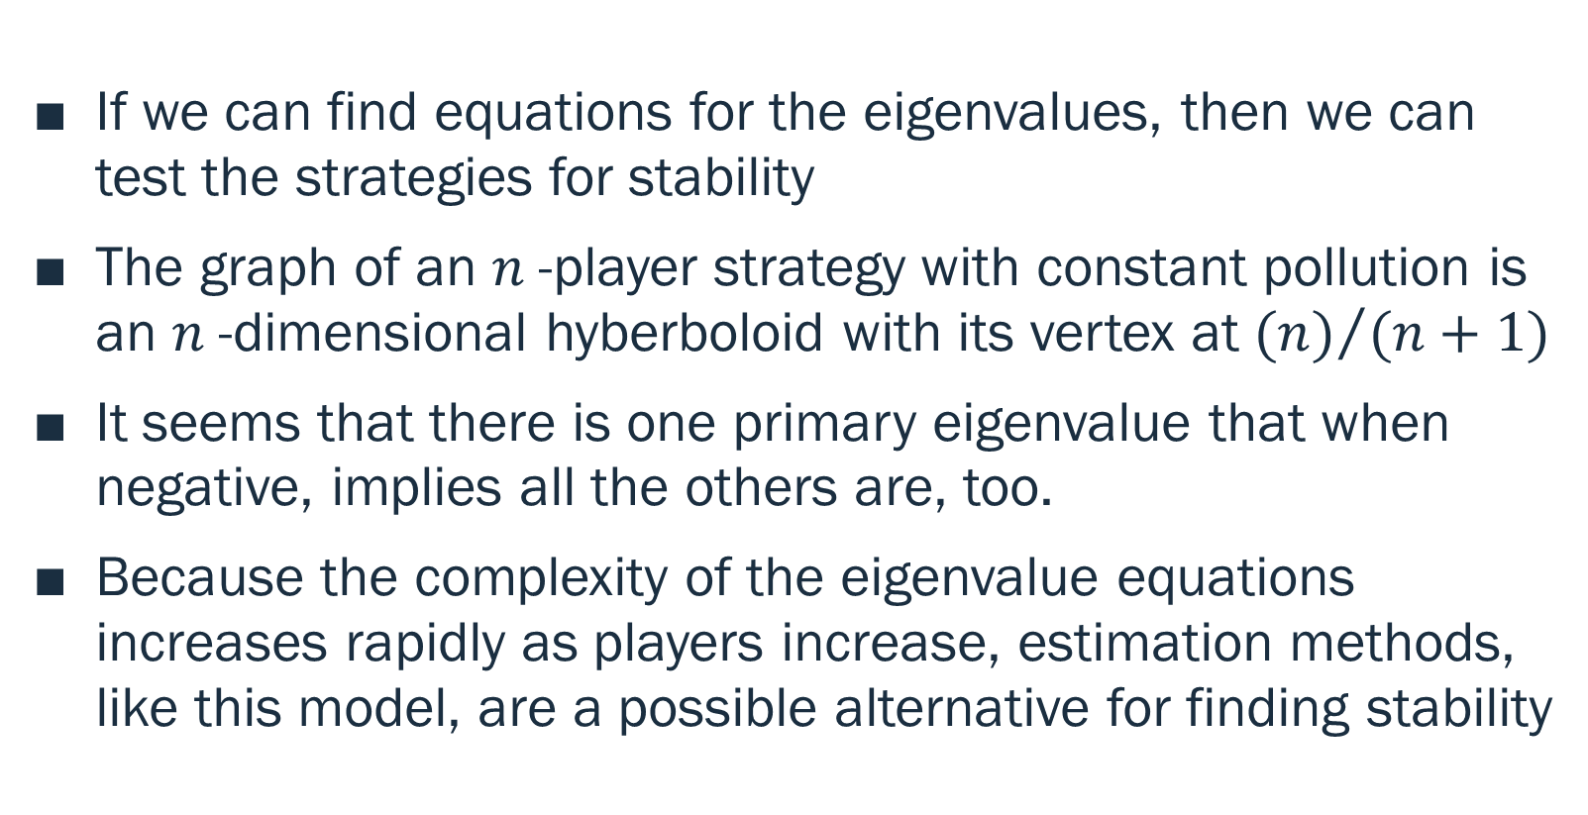
Conclusions:
If we can find equations for the eigenvalues, then we can test the strategies for stability
The graph of an $n$-player strategy with constant pollution is an $n$-dimensional hyberboloid with its vertex at ${(n)}/{(n+1)}$
It seems that there is one primary eigenvalue that when negative, implies all the others are, too.
Because the complexity of the eigenvalue equations increases rapidly as players increase, estimation methods, like this model, are a possible alternative for finding stability

Slide 28
Further Study for this Project
Evaluate n-step cyclic multi-layered strategies and their stability regions.
Formalize the project to the point of being able to accept realistic mappings and values.
Implement the cost efficiency strategy.

Slide 29
Tools used for this project: Programming Language: Python 3.5 IDE: Visual Studio Code GUI: PYQT5 PLOTTING: PYQTGRAPH ADDITIONAL: Wolfram Alpha (matrices) Geogebra.com (3-d graphing)
Mentor: Vladimir Alexeev

Slide 30
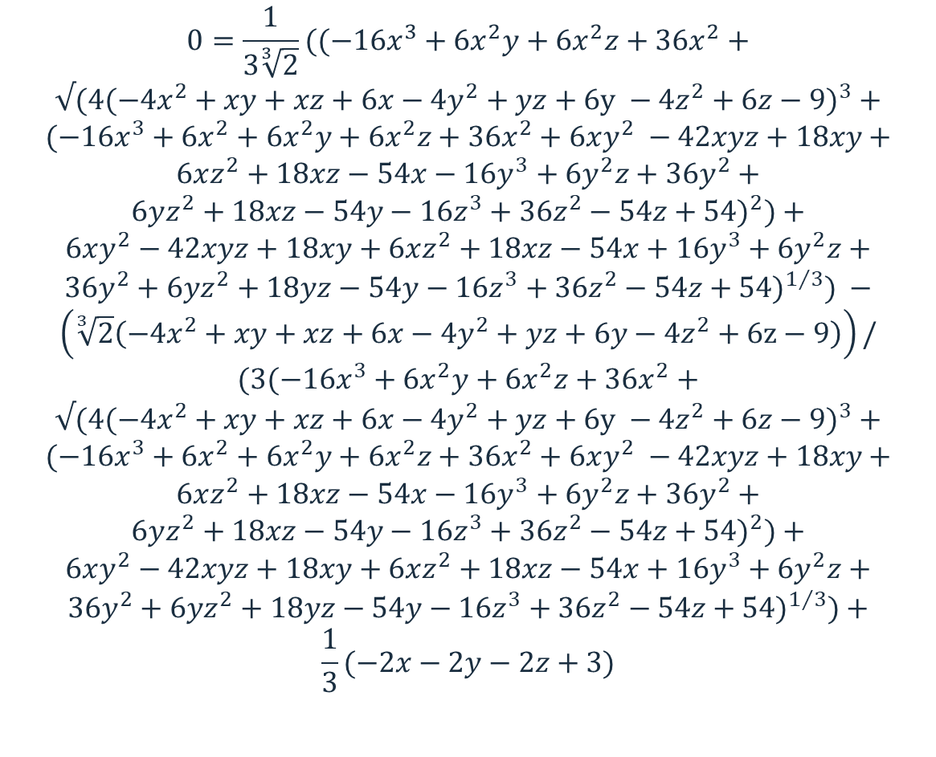
Three Players
$$0=\frac{1}{3\sqrt[3]{2}}((−{16x}^{3}+6x^{2}y+6x^{2}z+36x^{2}+$$
$$√(4(−4x^{2}+xy+xz+6x−4y^{2}+yz+6y −4z^{2}+6z−9)^{3}+$$
$$(−16x^{3}+6x^{2}+6x^{2}y+6x^{2}z+36x^{2}+6xy^{2} −42xyz+18xy+$$
$$6xz^{2}+18xz−54x−16y^{3}+6y^{2}z+36y^{2}+$$
$$6yz^{2}+18xz−54y−16z^{3}+36z^{2}−54z+54)^{2})+$$
$$6xy^{2}−42xyz+18xy+6xz^{2}+18xz−54x+16y^{3}+6y^{2}z+$$
$$36y^{2}+6yz^{2}+18yz−54y−16z^{3}+36z^{2}−54z+54)^{1/3}) −$$
$$\left(\sqrt[3]{2}\left(−4x^{2}+xy+xz+6x−4y^{2}+yz+6y−4z^{2}+6z−9\right)\right)/$$
$$(3(−16x^{3}+6x^{2}y+6x^{2}z+36x^{2}+$$
$$√(4(−4x^{2}+xy+xz+6x−4y^{2}+yz+6y −4z^{2}+6z−9)^{3}+$$
$$(−16x^{3}+6x^{2}+6x^{2}y+6x^{2}z+36x^{2}+6xy^{2} −42xyz+18xy+$$
$$6xz^{2}+18xz−54x−16y^{3}+6y^{2}z+36y^{2}+$$
$$6yz^{2}+18xz−54y−16z^{3}+36z^{2}−54z+54)^{2})+$$
$$6xy^{2}−42xyz+18xy+6xz^{2}+18xz−54x+16y^{3}+6y^{2}z+$$
$$36y^{2}+6yz^{2}+18yz−54y−16z^{3}+36z^{2}−54z+54)^{1/3})+$$
$$\frac{1}{3}(−2x−2y−2z+3)$$
YUUUUUUUUUUUUUUUUUUUUUUUUUCK

Slide 31

THE REAL WORK:
$\dot{x}=ax+f$ Let: $x=ce^{at}$
Then: $\dot{x}= \dot{c}e^{at}+ace^{at}$
Substitute: $\dot{c}e^{at}+ ace^{at}=ace^{at}+f$
$$\dot{c}e^{at}=f$$
$$\dot{c}= e^{−at}f$$
Integrate: $c=−\frac{e^{−at}}{a}f+ c_{0}$
$$x\left(t=0\right)=ce^{a∗0}=c=−\frac{e^{−a\left(0\right)}}{a}f+ c_{0}=−\frac{f}{a}+ c_{0}= x_{0}$$
$$c_{0}= x_{o}+ \frac{f}{a}$$
$$c=−\frac{e^{−at}}{a}f+ \frac{f}{a}+ x_{0}$$
$$x(t)=\left(x_{0} − \frac{e^{−at}}{a}f+ \frac{f}{a}\right)e^{at}$$
$$x(t)= x_{0}e^{at} − \frac{f}{a}+ \frac{fe^{at}}{a}$$
$$x(t)=x_{0}e^{at}+\frac{f}{a}(e^{at}−1)$$

